Slide 1
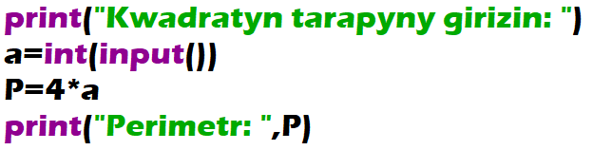
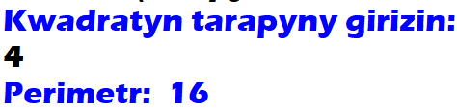
Given the side a of a square, find the perimeter P of the square: P = 4·a.

Slide 2
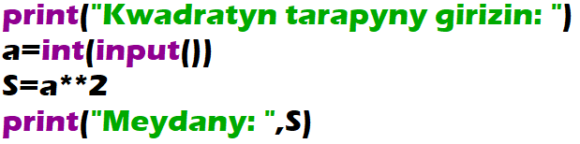
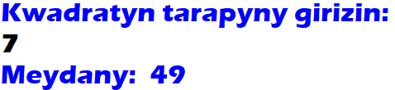
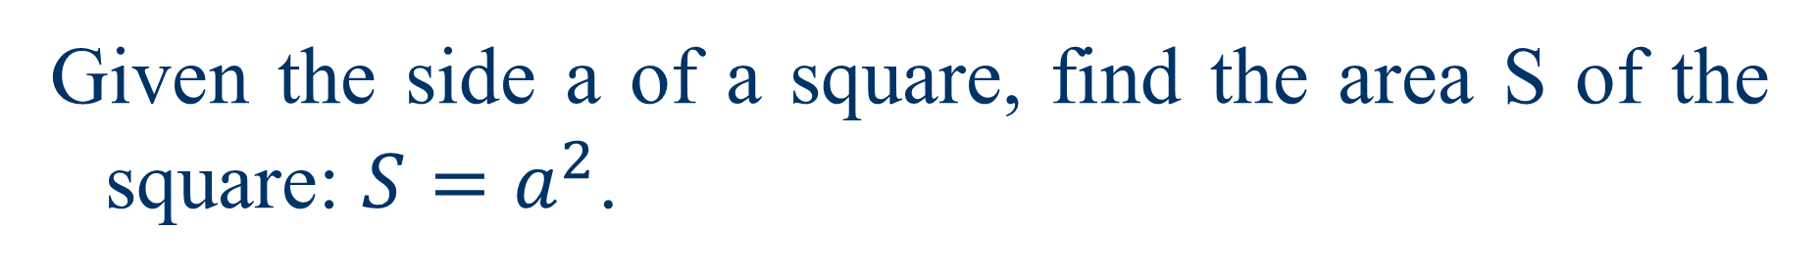
Given the side a of a square, find the area S of the square: $S=a^{2}$.

Slide 3
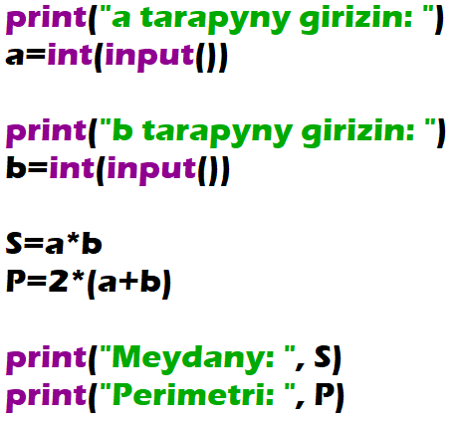
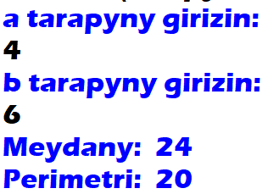
The sides a and b of a rectangle are given. Find the area S = a·b and the perimeter P = 2·(a + b) of the rectangle.

Slide 4
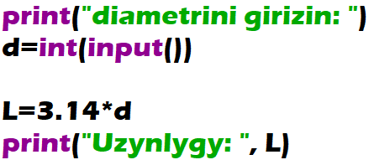
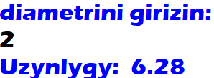
Given the diameter d of a circle, find the length L of the circle: L = π·d. Use 3.14 for a value of π.

Slide 5
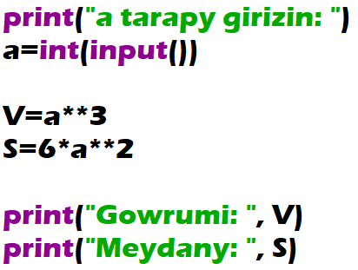
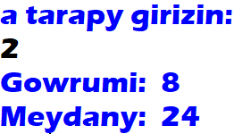
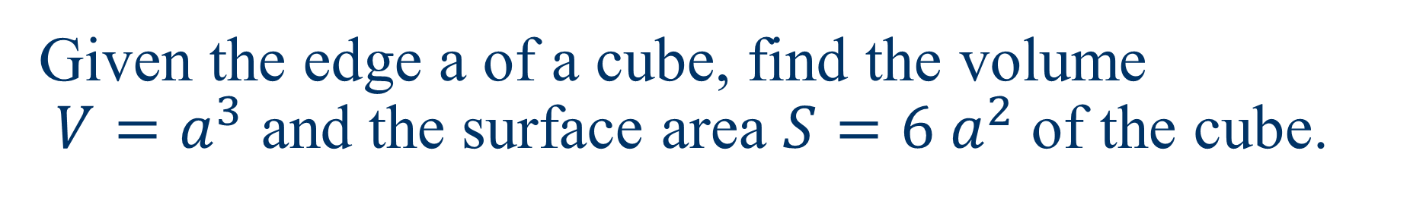
Given the edge a of a cube, find the volume $V=a^{3}$ and the surface area $S=6 a^{2}$ of the cube.

